Slide 1


Projeto MCZ03
Licenciatura em ENGENHARIA INFORMÁTICA / Graduation in Informatics engineering
Pontos de Controlo
32428 – Diogo Monteiro;
31396 – Gonçalo Teixeira.
Orientador(es):
Professor Doutor Miguel António Cruz
Licenciatura em Engenharia Informática | Escola Superior de Tecnologia e Gestão| Unidade Curricular: Projeto III | Ano Letivo 2024/2025

Slide 2

Ponto Controlo 0
www.ipvc.pt

Slide 3


■ Summary
Graduation in Informatics engineering
1. Introduction and Objectives
2. Functional and Non-Functional requirements
3. Use Cases, Users Analysis
  3.1 Users Analysis
  3.2 Use Cases
4. Data Sources
5. Conclusion and Future Work
6. Bibliography and Web References
@Diogo Monteiro - 32428, Gonçalo Teixeira - 31396 | Unidade Curricular: Projeto III – Ano Letivo 2024/2025 – MCZ03
- 3 -

Slide 4
■ 1. Introduction and Objectives
Graduation in Informatics engineering
■ This checkpoint focuses on the initial analysis and foundation of the project. The main work consists of gathering and documenting the system requirements, analyzing the types of users and actions, designing the use case model, and identifying an appropriate dataset for wildfire detection using satellite images.
■ Objectives:
Define functional and non-functional requirements
Identify key user roles and main interactions
Create the system’s use case diagram
Select and describe a relevant satellite image dataset
@Diogo Monteiro - 32428, Gonçalo Teixeira - 31396 | Unidade Curricular: Projeto III – Ano Letivo 2024/2025 – MCZ03
- 4 -

Slide 5
■ 2.1. Functional Requirements
Graduation in Informatics engineering
■ Main Functional Requirements
User: Register, login, upload images, add data, get results
Admin: Secure login, manage dataset, retrain model
System: Validate, analyze, store, notifyAccount: Register, log in/out, personalized access
■ Priorities
High: User operations & AI detection
Medium: History, notifications, privacy
Low: Dataset editing
@Diogo Monteiro - 32428, Gonçalo Teixeira - 31396 | Unidade Curricular: Projeto III – Ano Letivo 2024/2025 – MCZ03
- 5 -

Slide 6
■ 2.2. Non-Functional Requirements
Graduation in Informatics engineering
■ Performance & Scalability: Image analysis under 60s; support up to 100 users; scalable image storage.
■ Usability: Intuitive, responsive, and accessible interface
■ Security: Basic protection (HTTPS, authentication, safe data, prevent SQL/XSS)
■ Maintainability: Modular code structure; API documentation; logging/debug tools
■ Quality: AI model error rate below 5%; validate model before using
@Diogo Monteiro - 32428, Gonçalo Teixeira - 31396 | Unidade Curricular: Projeto III – Ano Letivo 2024/2025 – MCZ03
- 6 -

Slide 7
■ 3. Use Cases, Users Analysis, Class Diagram
Graduation in Informatics engineering
■ 3.1 Users Analysis
There are 3 types of users:
Regular User
Administrator
System
Register account
Log in/out
Upload image
Enter environment data
Submit for analysis
Get notifications
View history
Log in as admin
Upload training data
Edit or delete dataset entries
Trigger model retraining
Validate all inputs
Process images and data
Store images and metadata
Send notifications
@Diogo Monteiro - 32428, Gonçalo Teixeira - 31396 | Unidade Curricular: Projeto III – Ano Letivo 2024/2025 – MCZ03
- 7 -

Slide 8
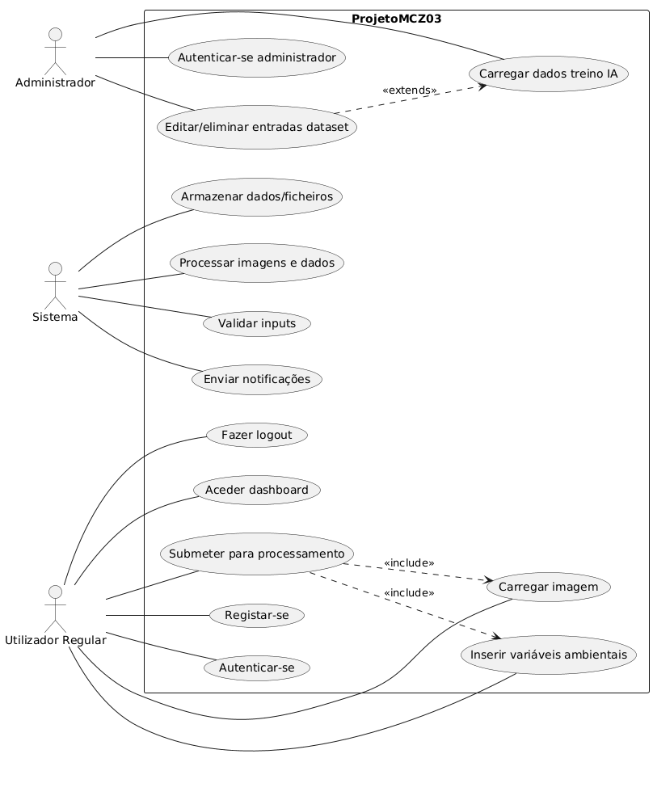
■ 3.2. Use Case Diagram
Graduation in Informatics engineering
@Diogo Monteiro - 32428, Gonçalo Teixeira - 31396 | Unidade Curricular: Projeto III – Ano Letivo 2024/2025 – MCZ03
- 8 -

Slide 9
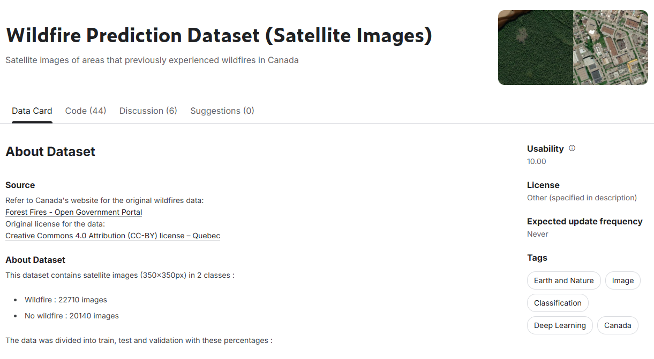
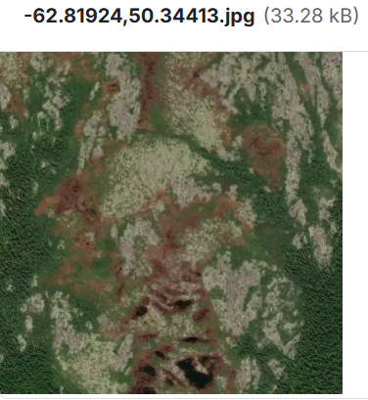
■ 4. Data Sources
Graduation in Informatics engineering
The dataset contains satellite images of regions affected by wildfires and regions without wildfires.
Provides labeled images (“wildfire" and "no wildfire") which will be used to train the model
Example statistics:
Wildfire images: 22,710
No wildfire images: 29,040
Images size: 150x150px
Publicly available on Kaggle, with metadata and labels for detection tasks.
@Diogo Monteiro - 32428, Gonçalo Teixeira - 31396 | Unidade Curricular: Projeto III – Ano Letivo 2024/2025 – MCZ03
- 9 -

Slide 10
■ 5. Conclusion
Graduation in Informatics engineering
■ In conclusion, this checkpoint establishes the essential foundations for the project by defining requirements, analyzing users, outlining use cases, and identifying a suitable dataset. With these elements in place, the project is ready to proceed to the design and development phases, ensuring a clear direction for building an effective wildfire detection platform.​
@Diogo Monteiro - 32428, Gonçalo Teixeira - 31396 | Unidade Curricular: Projeto III – Ano Letivo 2024/2025 – MCZ03
- 10 -

Slide 11
■ 5. Future Work
Graduation in Informatics engineering
■ Collect and prepare labeled fire/no fire image data
■ Train and validate the AI model with this data
■ Test the model and improve it
@Diogo Monteiro - 32428, Gonçalo Teixeira - 31396 | Unidade Curricular: Projeto III – Ano Letivo 2024/2025 – MCZ03
- 11 -

Slide 12
■ 6. Bibliography and Web References
Graduation in Informatics engineering
■ Wildfire Prediction Dataset (Satellite Images): https://www.kaggle.com/datasets/abdelghaniaaba/wildfire-prediction-dataset
■ Lucidchart: https://www.lucidchart.com/pages
@Diogo Monteiro - 32428, Gonçalo Teixeira - 31396 | Unidade Curricular: Projeto III – Ano Letivo 2024/2025 – MCZ03
- 12 -
Notes:
Tiago (acabar referencias)

Slide 13
Ponto Controlo 1
www.ipvc.pt

Slide 14
■ Summary
Graduation in Informatics engineering
1. Introduction and Objectives
2. Model Development and Training
3. Training Results and Performance
4. Model Testing with New Images
5. Conclusion and Future Work
6. Bibliography and Web References
@Diogo Monteiro - 32428, Gonçalo Teixeira - 31396 | Unidade Curricular: Projeto III – Ano Letivo 2024/2025 – MCZ03
- 14 -

Slide 15
■ 1. Introduction and Objectives
Graduation in Informatics engineering
■ This checkpoint focuses on the initial implementation and training of the wildfire detection model. The main work consists of preparing the dataset structure, developing a convolutional neural network (CNN) for binary image classification, training the model using satellite images from the Kaggle dataset, and evaluating its performance through validation metrics.
■ Objectives:
Prepare and organize the training dataset with wildfire and no_wildfire image classes
Develop a CNN architecture suitable for binary classification of satellite images
Train the model using TensorFlow/Keras with appropriate hyperparameters
Evaluate model performance through accuracy and loss metrics across training epochs
Test the trained model with new unseen images to verify prediction capabilities
@Diogo Monteiro - 32428, Gonçalo Teixeira - 31396 | Unidade Curricular: Projeto III – Ano Letivo 2024/2025 – MCZ03
- 15 -

Slide 16
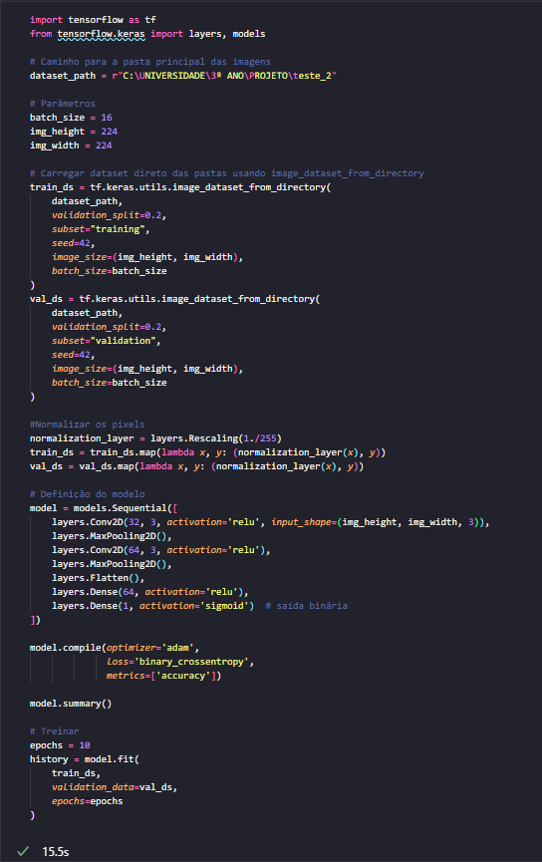
■ 2. Model Development and Training
Graduation in Informatics engineering
Dataset Preparation
The dataset was prepared using satellite images from Kaggle.
A total of 100 images were organized into two folders representing wildfire and non-wildfire scenarios, ensuring balanced representation of both classes.
Images organized by class
80/20 split for training and validation
All images resized and normalized
Model Creation
A CNN model was built to analyze the satellite images and classify them automatically.
@Diogo Monteiro - 32428, Gonçalo Teixeira - 31396 | Unidade Curricular: Projeto III – Ano Letivo 2024/2025 – MCZ03
- 16 -

Slide 17
■ 2. Model Development and Training
Graduation in Informatics engineering
The model learns to recognize visual patterns that distinguish wildfires from normal scenarios through multiple processing layers:
Binary classification model
Extracts features from images
Learns patterns automatically
Training Execution
The model was trained for 10 epochs, allowing it to progressively improve its accuracy. Standard optimization methods were used to ensure effective learning from the dataset.
10 training cycles
Progressive accuracy improvement
Validation at each epoch
@Diogo Monteiro - 32428, Gonçalo Teixeira - 31396 | Unidade Curricular: Projeto III – Ano Letivo 2024/2025 – MCZ03
- 17 -

Slide 18

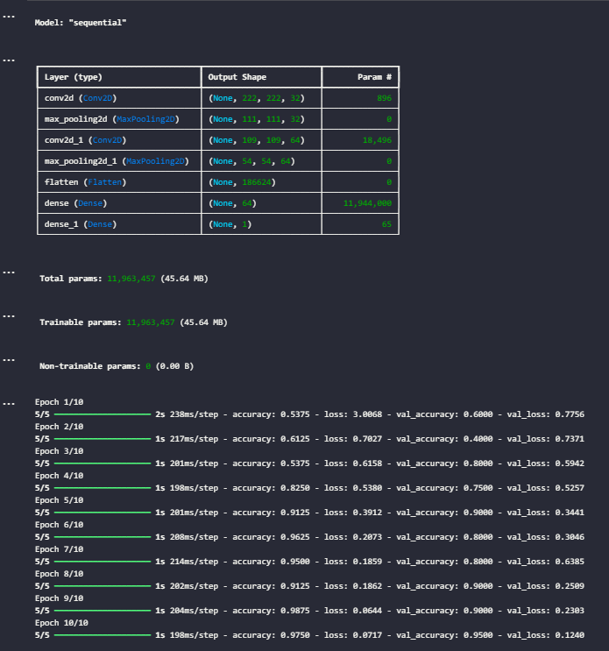
■ 3. Training Results and Performance
Graduation in Informatics engineering
Model Summary
The model architecture was successfully built with approximately 12 million trainable parameters distributed across convolutional, pooling, and dense layers.
Total parameters: 11,963,457
All parameters trainable
Sequential architecture confirmed
Training Execution
The model was trained for 10 epochs using 80 images for training and 20 for validation.
@Diogo Monteiro - 32428, Gonçalo Teixeira - 31396 | Unidade Curricular: Projeto III – Ano Letivo 2024/2025 – MCZ03
- 18 -

Slide 19
■ 3. Training Results and Performance
Graduation in Informatics engineering
Performance metrics were recorded at each epoch to monitor learning progress.
10 training epochs completed
Training set: 80 images
Validation set: 20 images
Performance Metrics
The model achieved strong performance, reaching approximately 95% validation accuracy by the final epoch. Both training and validation loss decreased consistently, indicating effective learning without overfitting.
Final validation accuracy: ~95%
Consistent loss reduction
Stable training progression
@Diogo Monteiro - 32428, Gonçalo Teixeira - 31396 | Unidade Curricular: Projeto III – Ano Letivo 2024/2025 – MCZ03
- 19 -

Slide 20
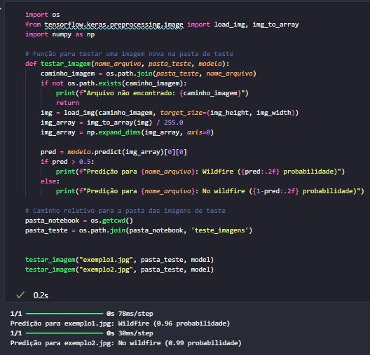
■ 4. Model Testing with New Images
Graduation in Informatics engineering
Test Implementation
A testing function was created to evaluate the model's performance on unseen images. This function loads new satellite images, processes them, and uses the trained model to make predictions.
Function to load and preprocess test images
Prediction threshold set at 0.5 probability
Output displays class and confidence level
Test Execution
Two example images were tested to verify the model's classification capabilities.
@Diogo Monteiro - 32428, Gonçalo Teixeira - 31396 | Unidade Curricular: Projeto III – Ano Letivo 2024/2025 – MCZ03
- 20 -

Slide 21
■ 4. Model Testing with New Images
Graduation in Informatics engineering
The model successfully processed both images and provided predictions with probability scores.
Test images from separate folder
Real-time prediction on new data
Confidence scores displayed
Test Results
The model correctly classified both test images, demonstrating its ability to generalize to unseen data. Predictions included probability scores showing confidence levels.
Example 1: Wildfire detected (0.96 probability)
Example 2: No wildfire (0.99 probability)
Model successfully generalized
@Diogo Monteiro - 32428, Gonçalo Teixeira - 31396 | Unidade Curricular: Projeto III – Ano Letivo 2024/2025 – MCZ03
- 21 -

Slide 22
■ 5. Conclusion
Graduation in Informatics engineering
■ In conclusion, this checkpoint successfully establishes the foundational model for the wildfire detection project by developing and training a CNN, evaluating its performance through multiple epochs, and testing its predictions on new unseen images. With these elements in place, the project is ready to proceed to the optimization and enhancement phases, ensuring a clear direction for building an effective and robust wildfire detection system.
@Diogo Monteiro - 32428, Gonçalo Teixeira - 31396 | Unidade Curricular: Projeto III – Ano Letivo 2024/2025 – MCZ03
- 22 -

Slide 23
■ 5. Future Work
Graduation in Informatics engineering
■ Optimize and refine the CNN model architecture for improved accuracy
■ Train the model with the complete Kaggle dataset (full-scale training)
■ Implement additional testing scenarios and validation methods
■ Integrate environmental variables (temperature, humidity, wind) into the model
■ Develop the complete wildfire detection platform interface
@Diogo Monteiro - 32428, Gonçalo Teixeira - 31396 | Unidade Curricular: Projeto III – Ano Letivo 2024/2025 – MCZ03
- 23 -

Slide 24
■ 6. Bibliography and Web References
Graduation in Informatics engineering
■ Wildfire Prediction Dataset (Satellite Images): https://www.kaggle.com/datasets/abdelghaniaaba/wildfire-prediction-dataset
■ TensorFlow Documentation: https://www.tensorflow.org/
■ Keras Documentation: https://keras.io/
@Diogo Monteiro - 32428, Gonçalo Teixeira - 31396 | Unidade Curricular: Projeto III – Ano Letivo 2024/2025 – MCZ03
- 24 -
Notes:
Tiago (acabar referencias)

Slide 25
Ponto Controlo 2
www.ipvc.pt

Slide 26
■ Summary
Graduation in Informatics engineering
Introduction and Objectives
Environment Setup and Dataset Organization
Data Preparation and Cleaning
Model Development and Architecture
Model Summary and Analysis
Training Configuration
Training Results
Model Testing
Conclusion and Future Work
Bibliography and Web References
@Diogo Monteiro - 32428, Gonçalo Teixeira - 31396 | Unidade Curricular: Projeto III – Ano Letivo 2024/2025 – MCZ03
- 26 -

Slide 27
■ 1. Introduction and Objectives
Graduation in Informatics engineering
■ This checkpoint focuses on improving data integrity and refining the wildfire detection model. The main work consists of implementing robust data cleaning processes to remove corrupt files, restructuring the dataset into explicit splits, and training a Convolutional Neural Network (CNN).
■ Objectives:
Implement data validation scripts to ensure dataset integrity before training.
Structure the dataset into clear Train, Validation, and Test directories.
Develop and train a new CNN architecture with optimized input dimensions (160x160).
Evaluate model performance using a dedicated test set.
@Diogo Monteiro - 32428, Gonçalo Teixeira - 31396 | Unidade Curricular: Projeto III – Ano Letivo 2024/2025 – MCZ03
- 27 -

Slide 28
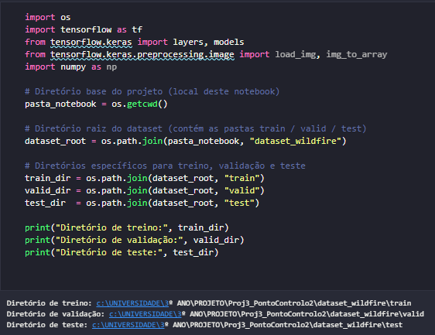
■ 2. Environment Setup and Dataset Organization
Graduation in Informatics engineering
Project Structure:
Before training, we established a clear reference to the dataset directories. This cell imports necessary libraries (TensorFlow, Keras) and maps the file paths for the three data splits.
Imports: Loading essential libraries like os, numpy, and tensorflow.
Path Definition: Dynamically sets the paths for train, valid, and test directories based on the project root.
Verification: Ensures the code is pointing to the correct folders on the disk.
@Diogo Monteiro - 32428, Gonçalo Teixeira - 31396 | Unidade Curricular: Projeto III – Ano Letivo 2024/2025 – MCZ03
- 28 -

Slide 29
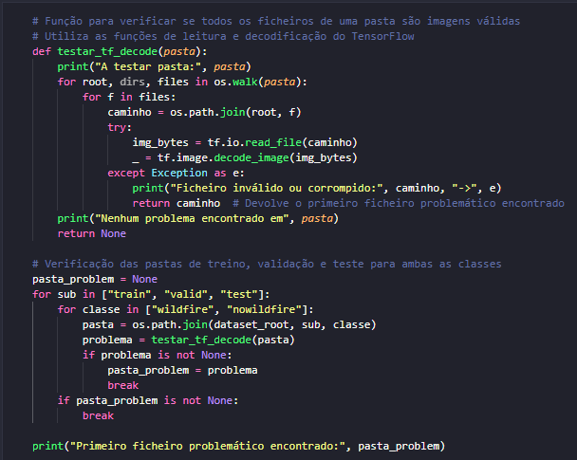
■ 2. Data Preparation and Cleaning
Graduation in Informatics engineering
Data Integrity Check:
A validation function was implemented to scan all dataset directories. This ensures that only valid, readable images are fed into the model, preventing training interruptions caused by corrupt files:
Iterates through all subfolders (wildfire/nowildfire).
Uses tf.io.decode_image to verify file structure.
Automatically identifies and reports problematic files.
Dataset Structure:
The data was explicitly organized into three distinct sets to ensure proper model evaluation:
Training: For learning features.
Validation: For tuning during epochs.
Testing: For final unbiased evaluation.
@Diogo Monteiro - 32428, Gonçalo Teixeira - 31396 | Unidade Curricular: Projeto III – Ano Letivo 2024/2025 – MCZ03
- 29 -

Slide 30
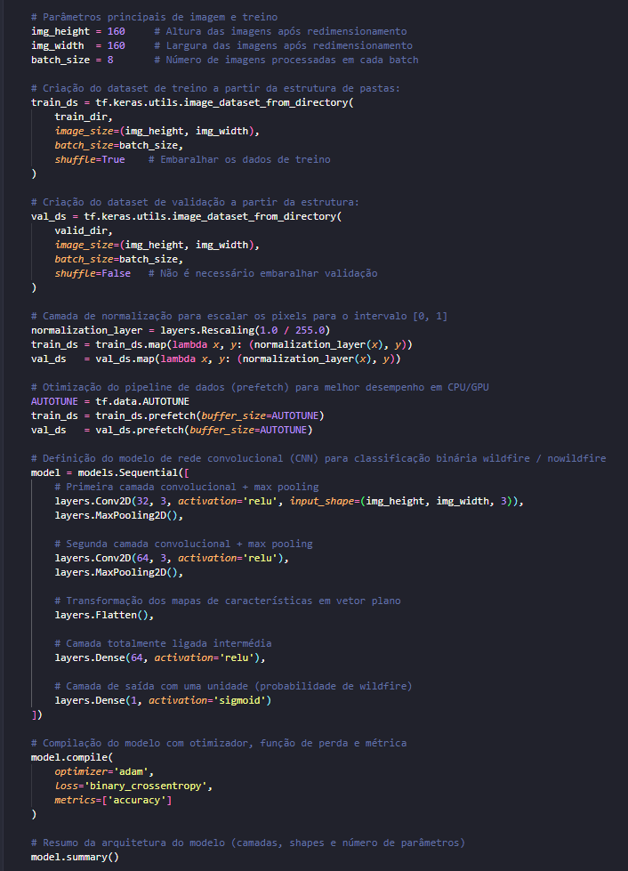
■ 3. Model Development and Architecture
Graduation in Informatics engineering
Model Architecture:
A Sequential CNN was designed to process 160x160 RGB images. The architecture balances complexity and performance, utilizing approximately 5.9 million parameters.
Input Layer: 160x160 pixels (Rescaled 1./255).
Convolutional Layers: Two blocks (32 and 64 filters) with MaxPooling to extract features.
Dense Layers: A fully connected layer with 64 neurons followed by a Sigmoid output layer for binary classification.
Training Configuration:
Batch Size: 8 (Optimized for memory usage).
Optimizer: Adam.
Loss Function: Binary Crossentropy.
@Diogo Monteiro - 32428, Gonçalo Teixeira - 31396 | Unidade Curricular: Projeto III – Ano Letivo 2024/2025 – MCZ03
- 30 -

Slide 31
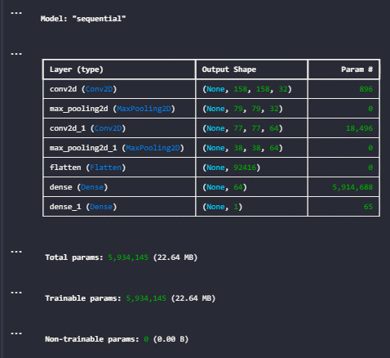
■ 3.1. Model Summary and Analysis
Graduation in Informatics engineering
Layer Details:
The model summary confirms the sequential data transformation. As the image passes through the layers, its spatial dimensions decrease (from 158x158 to 38x38), while the depth (number of feature maps) increases.
Parameter Distribution:
Total Parameters: 5,934,145 (approx. 5.9 million).
Dense Layer Impact: The vast majority of these parameters are located in the first dense layer (dense), where the flattened features are connected to the 64 neurons.
Trainable: All parameters are set to be trainable, allowing the model to fully adapt to the specific features of the wildfire dataset.
@Diogo Monteiro - 32428, Gonçalo Teixeira - 31396 | Unidade Curricular: Projeto III – Ano Letivo 2024/2025 – MCZ03
- 31 -

Slide 32
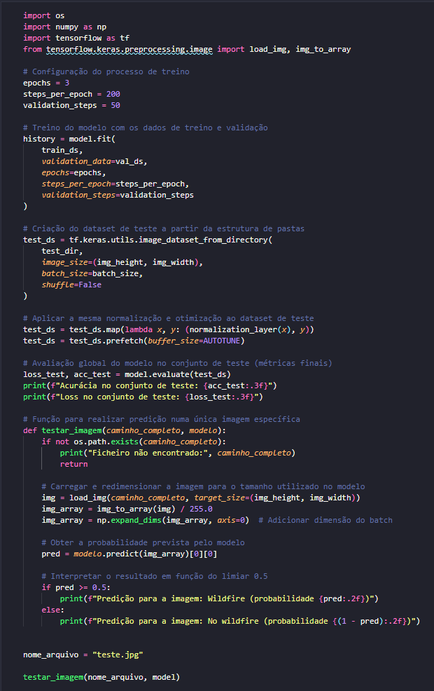
■ 4. Training Configuration
Graduation in Informatics engineering
Code Implementation:
The training process was configured using the model.fit() method with specific parameters to ensure stable learning and avoid overfitting.
Epochs: Set to 3 to prevent overfitting while allowing sufficient learning time for the initial baseline.
Steps per Epoch: Fixed at 200 to control the exact number of batches processed per cycle.
Validation Steps: Set to 50, ensuring a consistent evaluation of the model's progress during training.
@Diogo Monteiro - 32428, Gonçalo Teixeira - 31396 | Unidade Curricular: Projeto III – Ano Letivo 2024/2025 – MCZ03
- 32 -

Slide 33
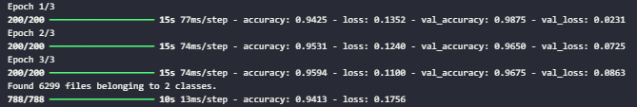
■ 5. Training Results
Graduation in Informatics engineering
Performance Outcomes:
The execution output shows rapid model convergence. By the final epoch, the metrics indicated strong performance:
Final Training Accuracy: ~95.9% (High accuracy on training data).
Final Validation Accuracy: ~96.7% (Excellent generalization on unseen validation data).
Loss Trend: Both training and validation loss decreased consistently, validating the effectiveness of the architecture.
@Diogo Monteiro - 32428, Gonçalo Teixeira - 31396 | Unidade Curricular: Projeto III – Ano Letivo 2024/2025 – MCZ03
- 33 -

Slide 34
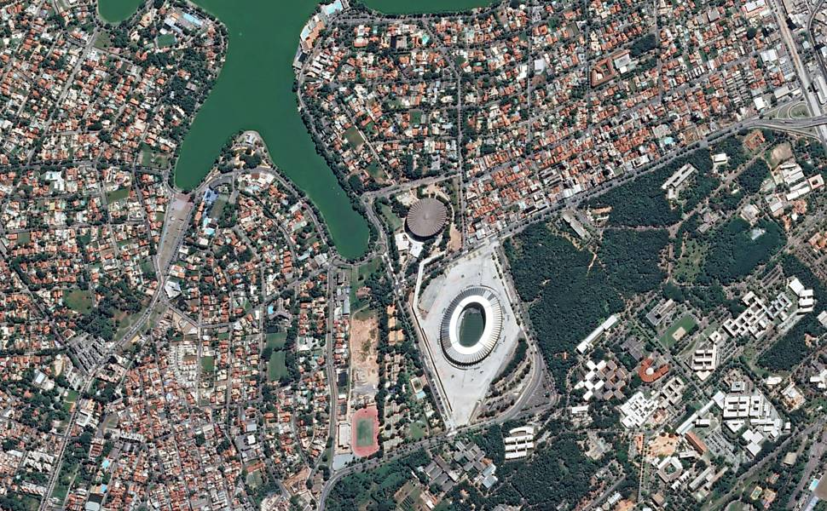

■ 6. Model Testing
Graduation in Informatics engineering
Global Evaluation:
The model achieved strong generalization capabilities on the full test dataset, with a Test Accuracy of 94.1% and a low Loss of 0.176.
Single Image Validation: To demonstrate practical application, we tested the model with a specific standalone satellite image ("teste.jpg").
Method: The image was loaded, resized to 160x160, and processed by the model.
Result: The model successfully classified the image (e.g., "No Wildfire") with high confidence (100%), demonstrating its ability to handle individual real-world inputs outside the dataset batch structure.
teste.jpg
@Diogo Monteiro - 32428, Gonçalo Teixeira - 31396 | Unidade Curricular: Projeto III – Ano Letivo 2024/2025 – MCZ03
- 34 -

Slide 35
■ 7. Conclusion and Future Work
Graduation in Informatics engineering
■ In this checkpoint, we successfully established a clean data pipeline and trained a highly accurate CNN (94.1% test accuracy). The implementation of data validation scripts significantly improved the stability of the training process.
Future Work:
Model Diversification: Develop and train additional model architectures to compare performance against the current baseline.
Dataset Expansion: Actively research and integrate new high-quality datasets (if found) to test the model's adaptability to different terrains and conditions.
Environmental Integration: Begin exploring methods to integrate non-image data (temperature, wind) if feasible.
@Diogo Monteiro - 32428, Gonçalo Teixeira - 31396 | Unidade Curricular: Projeto III – Ano Letivo 2024/2025 – MCZ03
- 35 -

Slide 36
■ 8. Bibliography and Web References
Graduation in Informatics engineering
■ Wildfire Prediction Dataset (Satellite Images): https://www.kaggle.com/datasets/abdelghaniaaba/wildfire-prediction-dataset
■ TensorFlow Documentation: https://www.tensorflow.org/
■ Keras Documentation: https://keras.io/
@Diogo Monteiro - 32428, Gonçalo Teixeira - 31396 | Unidade Curricular: Projeto III – Ano Letivo 2024/2025 – MCZ03
- 36 -
Notes:
Tiago (acabar referencias)

Slide 37
Ponto Controlo 2
www.ipvc.pt

Slide 38
■ Summary
Graduation in Informatics engineering
Introduction and Objectives
Dataset Contextualization (FlameVision)
Model Architecture and Implementation
Training Configuration and Results
Conclusion and Future Work
Bibliography and Web References
@Diogo Monteiro - 32428, Gonçalo Teixeira - 31396 | Unidade Curricular: Projeto III – Ano Letivo 2024/2025 – MCZ03
- 38 -

Slide 39
■ 1. Introduction and Objectives
Graduation in Informatics engineering
■ This checkpoint focuses on developing a wildfire detection model using the FlameVision aerial imagery dataset and preparing it for web platform integration through preprocessing, model training, and validation.
■ Objectives:
Validate and structure the FlameVision dataset into Train, Validation, and Test splits.
Implement data preprocessing and augmentation for aerial wildfire image classification.
Develop and train a CNN classifier (EfficientNet-B0) for fire/no-fire binary detection.
Evaluate model performance on validation and test sets.
Export trained model for FastAPI backend integration.
@Diogo Monteiro - 32428, Gonçalo Teixeira - 31396 | Unidade Curricular: Projeto III – Ano Letivo 2024/2025 – MCZ03
- 39 -

Slide 40
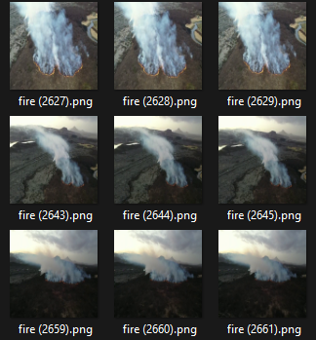
■ 2. Model Architecture Implementation
Graduation in Informatics engineering
The FlameVision dataset was selected to replace the previous wildfire prediction model. It provides labeled aerial imagery optimized for fire detection classification tasks rather than temporal prediction.
FlameVision Dataset Overview:
Dataset: 8,600 high-resolution aerial images captured by UAVs
Classes: fire (5,000 images) and no-fire (3,600 images)
Image Format: PNG for classification tasks
Data Split: 6,800 training | 900 validation | 900 test images
Source: Mendeley Data (fgvscdjsmt)
Application Domain: Aerial wildfire detection and monitoring from drone imagery
Mendeley Data, V4, doi: 10.17632/fgvscdjsmt.4
@Diogo Monteiro - 32428, Gonçalo Teixeira - 31396 | Unidade Curricular: Projeto III – Ano Letivo 2024/2025 – MCZ03
- 40 -

Slide 41
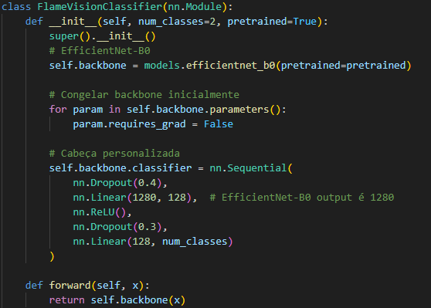
■ 5. Dataset Contextualization
Graduation in Informatics engineering
The FlameVisionClassifier uses EfficientNet-B0 with transfer learning and a custom classification head for binary fire detection.
Architecture:
Base Model: EfficientNet-B0 (ImageNet pre-trained)
Frozen Backbone: Preserves learned features
Custom Head: 1280 → 128 → 2 (fire/no-fire)
Regularization: Dropout (0.4, 0.3)
Output: Binary classification logits
Features:
Efficient with minimal computational overhead
Transfer learning reduces training time
Modular design for production deployment
@Diogo Monteiro - 32428, Gonçalo Teixeira - 31396 | Unidade Curricular: Projeto III – Ano Letivo 2024/2025 – MCZ03
- 41 -

Slide 42

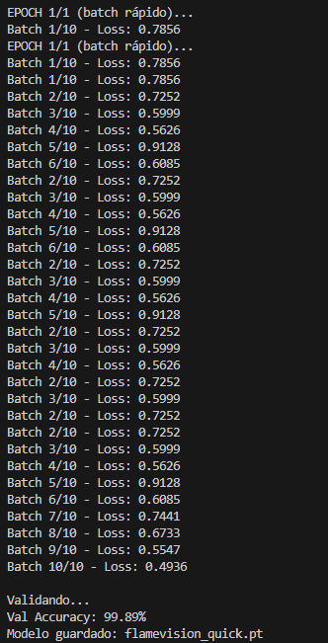
■ 6. Training Results
Graduation in Informatics engineering
Training Configuration:
Dataset: 6,800 training | 900 validation | 900 test images
Classes: fire / no-fire (binary classification)
Training Strategy: 10 batches per epoch (demonstration run)
Optimizer: Adam (learning rate: 1e-3)
Loss Function: Cross-Entropy Loss
Performance:
Validation Accuracy: 99.89%
Model Status: Successfully trained and saved
Deployment: Ready for FastAPI backend integration
@Diogo Monteiro - 32428, Gonçalo Teixeira - 31396 | Unidade Curricular: Projeto III – Ano Letivo 2024/2025 – MCZ03
- 42 -

Slide 43
■ 7. Conclusion and Future Work
Graduation in Informatics engineering
■ In this checkpoint, we successfully developed and trained a fire detection classifier achieving 99.89% validation accuracy on the FlameVision dataset. The implementation demonstrates the viability of transfer learning with EfficientNet-B0 for aerial wildfire detection.
Future Work:
Model Optimization: Fine-tune hyperparameters and explore advanced architectures for improved robustness.
Backend Integration: Implement FastAPI endpoints for real-time inference and integrate with PostgreSQL database for image cataloging.
Frontend Development: Build React interface for image upload, classification display, and metadata management.
Platform Validation: Deploy complete web platform and validate end-to-end fire detection workflow.
Extended Evaluation: Test model performance on additional aerial imagery datasets and environmental conditions.
@Diogo Monteiro - 32428, Gonçalo Teixeira - 31396 | Unidade Curricular: Projeto III – Ano Letivo 2024/2025 – MCZ03
- 43 -

Slide 44
■ 8. Bibliography and Web References
Graduation in Informatics engineering
■ FlameVision Dataset: https://data.mendeley.com/datasets/fgvscdjsmt/4
■ PyTorch Documentation and Transfer Learning: https://pytorch.org/
■ EfficientNet Research and Implementation: https://github.com/lukemelas/EfficientNet-PyTorch
@Diogo Monteiro - 32428, Gonçalo Teixeira - 31396 | Unidade Curricular: Projeto III – Ano Letivo 2024/2025 – MCZ03
- 44 -
Notes:
Tiago (acabar referencias)

Slide 45
www.ipvc.pt

